Slide 1
Credit Card Segmentation
Machine Learning Project
Submitted by :-
Vattan Bali (2K18/EE/236)
Yatin Ahlawat (2K18/EE/250)

Slide 2
"Credit cards aren't banking - they're information"
300 billion credit card transactions take place each year , creating 300 billion opportunities to understand customers better. Unfortunately, many banks remain ignorant of this wealth of information at their disposal, and they opt for mass marketing and costly ATL advertising.

Slide 3
Customer segmentation is one of the most fundamental building blocks in getting to know customers. It is essential for industries where customer interaction is frequent and varied, as each interaction provides insight into opportunities and risks for every individual. The credit card industry is on par with telecommunications, e-commerce, and retail from this perspective, and the industry gains significant ROI from segmentation initiatives. Surprisingly, all around the world, there are many banks still not taking advantage of this opportunity, frequently due to a lack of tools or in-house resources to process and digest big data sources, sitting on top of a gold mine that erodes each day when left untouched.

Slide 4
Introducing Micro-Segmentation
Customer segmentation can be defined as the action of grouping similar customers into categories with the objective of customizing offerings and actions based on their profiles. The output is a list of customers, each tagged with segment flags using a segmentation ‘model’. The complexity of these models can range from a simple set of business rules - such as customers who haven’t used their cards last year - to sophisticated data mining codes.
In the early days, most companies had only 1 segmentation model that was based on customer demographics, value, behavior, needs, or a mix of these. While these models served early marketing needs well, as the sophistication of products and the number of customers is increasing, more comprehensive approaches are being sought after and are emerging - such as micro-segmentation and segment of one.

Slide 5
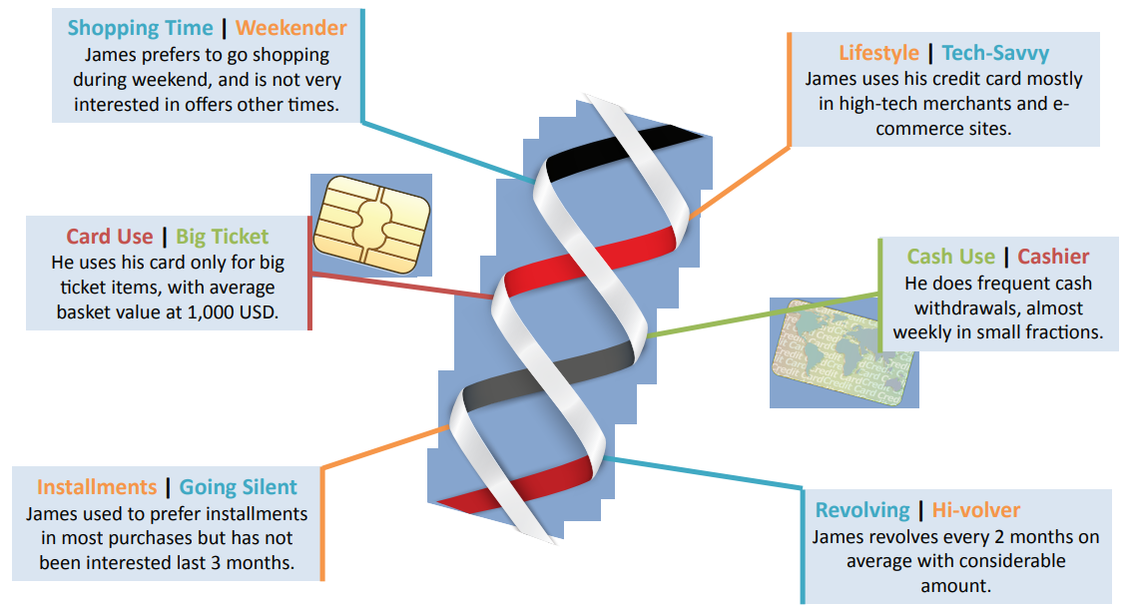

Slide 6
Uses in Credit Card Marketing
Within credit card marketing, customer segmentation can be used across the board for customer value and lifecycle management, including but not limited to:
I. Increasing the share of wallet and becoming the primary card via identification of high-potential cardholders
II. Encouraging cross-sales of secondary cards and other banking products based on comprehensive customer understanding
III. Selectively upgrading card limits and tiers for maximum return on risk

Slide 7
IV. Retaining the most valuable customers by accurately evaluating customer value and attrition risk
V. Maximizing profitability from payment operations, and migrating customers to more profitable payment products and interaction channels
VI. Guaranteeing long-term satisfaction and loyalty by increasing relevance in communications and offers.
Customer segmentation also acts as a building block for predictive analytics, as well as for campaign management and monitoring activities, providing a granular view of different customer profiles that have the potential to act and react differently.

Slide 8
Cardholder Behavioral Segments
Credit card data are rich in terms of both volume and variety, providing insights into both customer shopping and payment preferences. As a result, apart from the traditional customer demographics and value segmentations, credit card data requires customer behavior to be analyzed from many perspectives. This is why the microsegmentation approach is relevant for the credit card industry and frequently used. Every market and customer portfolio is different due to similarities in the nature of the transaction and statement data as well as in common product characteristics. However, there are some behavioral micro-segmentation models that can address the requirements of most card providers. Eight of these frequently used models that utilize the basic transaction and statement data to full extent are listed below.

Slide 9
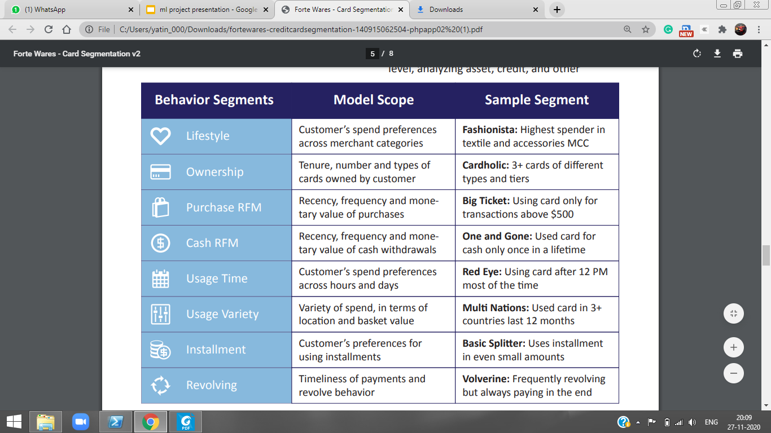

Slide 10
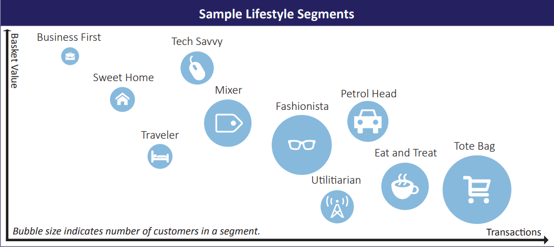

Slide 11
Supervised learning
Supervised learning is where you have input variables (x) and an output variable (Y) and you use an algorithm to learn the mapping function from the input to the output.
Y = f(X)
Regression -Predict for a value where the value is a continuous number
Classification- Predict for a value where the value is a categorical value
Time Series - Forecasting-Predict for a value where the value is a continuous number

Slide 12
Unsupervised learning
Unsupervised learning is where you only have input data (X) and no corresponding output variables.
The goal for unsupervised learning is to model the underlying structure or distribution in the data in order to learn more about the data
Segmentation / Clustering- Grouping the data in unknown number of segments
.

Slide 13
DATA METRICS USED
BALANCE
BALANCE_FREQUENCY
PURCHASES
ONEOFF_PURCHASES
INSTALLMENTS_PURCHASES
CASH_ADVANCE
PURCHASES_FREQUENCY
ONEOFF_PURCHASES_FREQUENCY
PURCHASES_INSTALLMENTS_FREQUENCY
CASH_ADVANCE_FREQUENCY
CASH_ADVANCE_TRX
PURCHASES_TRX
CREDIT_LIMIT
PAYMENTS
MINIMUM_PAYMENTS
PRC_FULL_PAYMENT
TENURE

Slide 14
Deriving Key Performance Indicators
Monthly average purchase
Monthly cash Advance amount
Purchase by type(on-off/installment)
Limit Usage
Payment to minimum payment ratio

Slide 15
Clustering
It is basically a type of unsupervised learning method .
Clustering is the task of dividing the population or data points into a number of groups such that data points in the same groups are more similar to other data points in the same group and dissimilar to the data points in other groups. It is basically a collection of objects on the basis of similarity and dissimilarity between them.
Clustering is very much important as it determines the intrinsic grouping among the unlabeled data present. There are no criteria for a good clustering. It depends on the user, what is the criteria they may use which satisfy their need

Slide 16
K-means algoritm
Kmeans algorithm is an iterative algorithm that tries to partition the dataset into Kpre-defined distinct non-overlapping subgroups (clusters) where each data point belongs to only one group.It tries to make the intra-cluster data points as similar as possible while also keeping the clusters as different (far) as possible.

Slide 17
How it works?
The way kmeans algorithm works is as follows:
Specify number of clusters K.
Initialize centroids by first shuffling the dataset and then randomly selecting K data points for the centroids without replacement.
Keep iterating until there is no change to the centroids. i.e assignment of data points to clusters isn’t changing.
Compute the sum of the squared distance between data points and all centroids.
Assign each data point to the closest cluster (centroid).
Compute the centroids for the clusters by taking the average of the all data points that belong to each cluster.
The approach kmeans follows to solve the problem is called Expectation-Maximization.

Slide 18
Finding the optimum cluster solution
Silhouette Coefficient:
Silhouette Coefficient or silhouette score is a metric used to calculate the goodness of a clustering technique. Its value ranges from -1 to 1.
1: Means clusters are well apart from each other and clearly distinguished.
0: Means clusters are indifferent, or we can say that the distance between clusters is not significant.
-1: Means clusters are assigned in the wrong way.

Slide 19
Elbow Analysis to find optimum solution
To determine the optimal number of clusters, we have to select the value of k at the “elbow” ie the point after which the distortion/inertia start decreasing in a linear fashion.
Distortion: It is calculated as the average of the squared distances from the cluster centers of the respective clusters. Typically, the Euclidean distance metric is used.
Inertia: It is the sum of squared distances of samples to their closest cluster center.

Slide 20
ANALYSIS

Slide 21
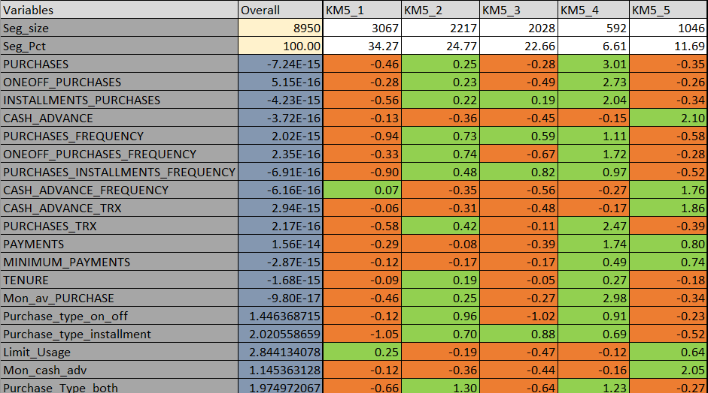

Slide 22
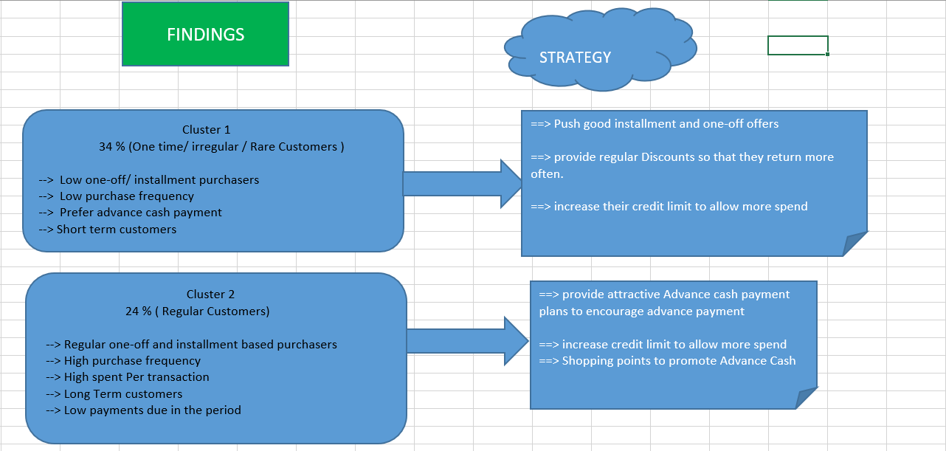

Slide 23
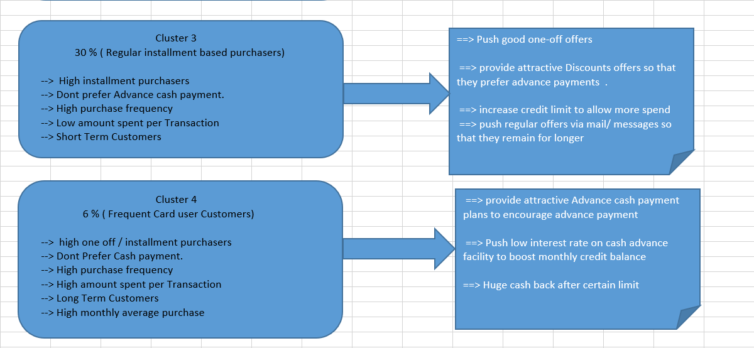

Slide 24
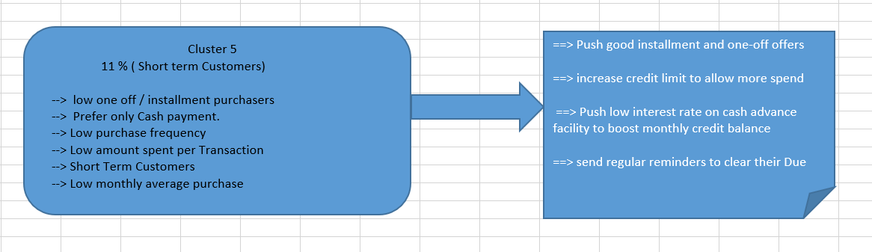

Slide 25
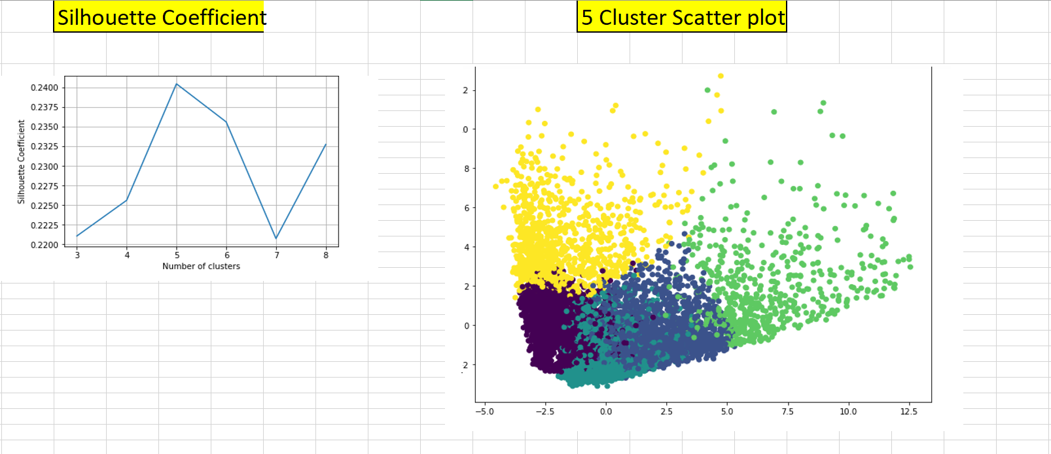

Slide 26
THANK YOU!
Detailed analysis in the excel file given.

